Slide 1
Online Retail App
Amrinder Singh(300984052)
Gagandeep Singh (300991854)
Gurjit Singh (300976262)
Jasneet Kaur (300961578)

Slide 2
Requirements
Who is going to use this application?
Customers who need household items such as furniture, electronic devices
How will they use this application?
Install the Apk version
What data should be inputted into this application?
Customers details (name, email, phone number)
Card details (card number, expiry date, cvv)
What data should be resulted by this application?
Successful payment
Order confirmation message on customer’s Mobile Number

Slide 3
Functionalities
Online purchase and payment
SMS service
Long running service- Playing background music
Use of network resource- online images

Slide 4
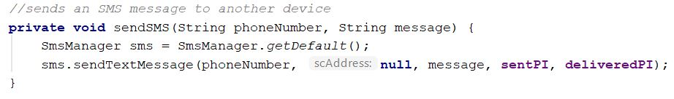
SMS Service
SMS permissions in AndroidManifest.xml
Built-in SmsManager class
Two PendingIntent object
sentPI
deliveredPI
Register two BroadcastReceivers
BroadcastReceiver subclass to listen to incoming sms

Slide 5
Background Services
We have used a background service : playing background music
We can start and stop the music manually.
It is a parallel processing which means two process are working together such that music is playing in the back and and the other process are working simultaneously.
For example when we type in word document , spell check is working in the background.

Slide 6
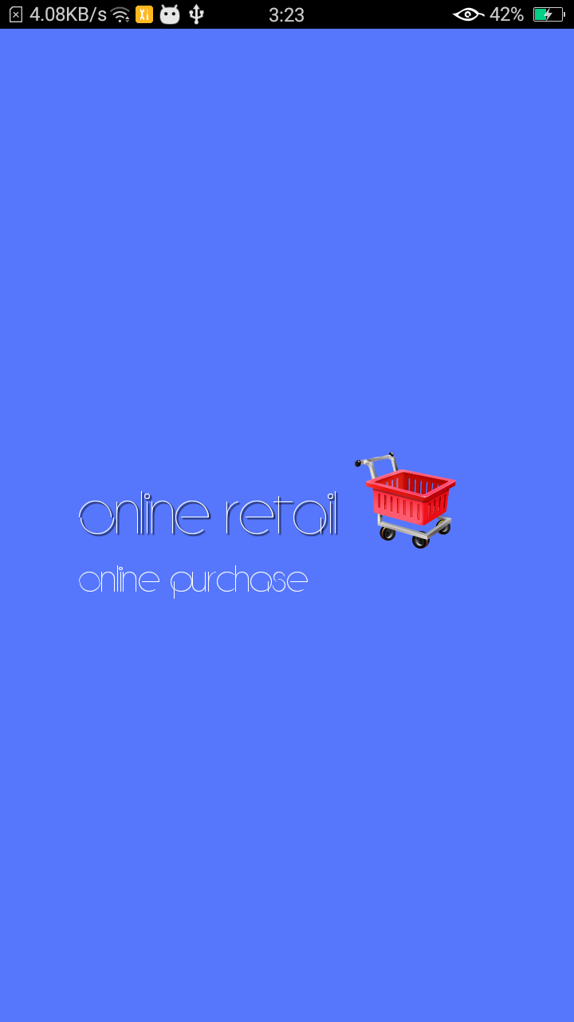
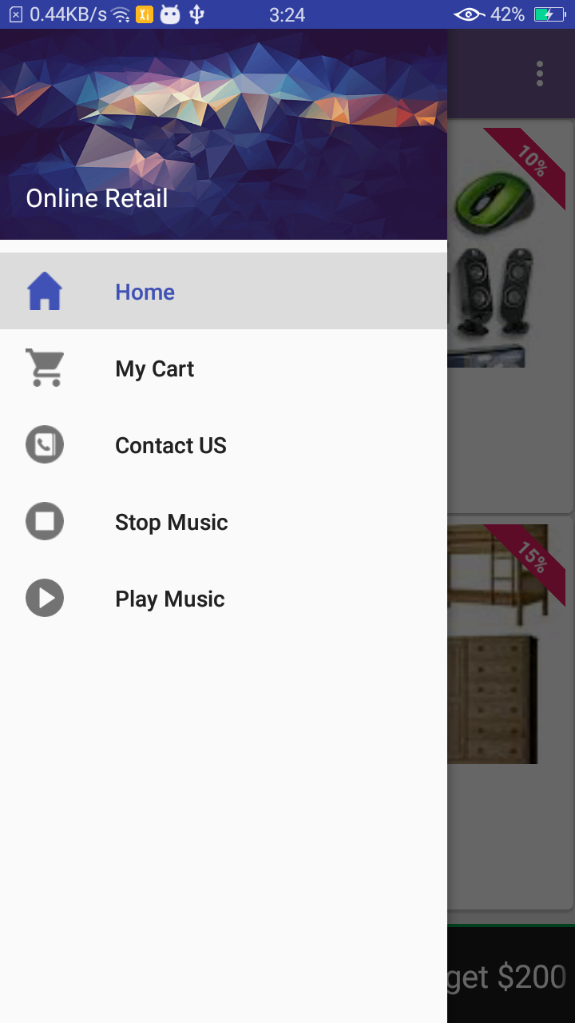
Screenshots:
Sidebar Menu
User can see Mycart.
Play music.
Stop music.

Slide 7
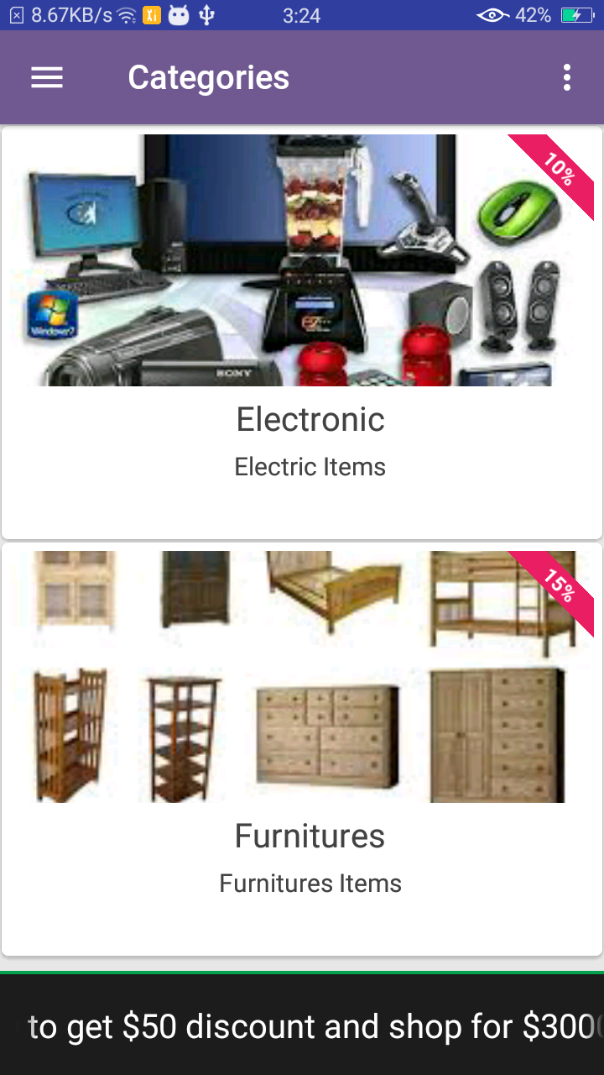
Categories:
Category options:
Electronics Items.
Furnitures Items.

Slide 8
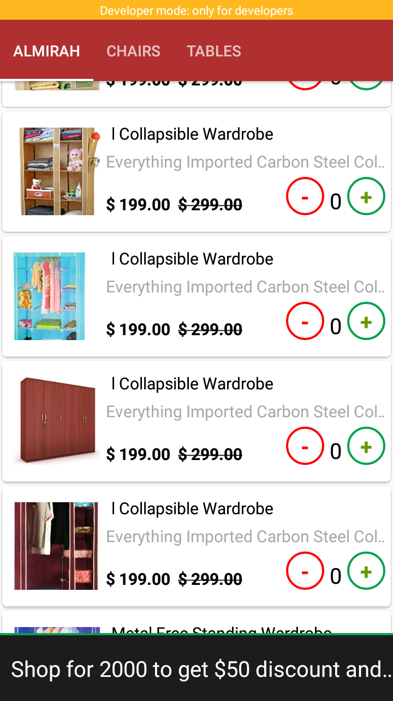
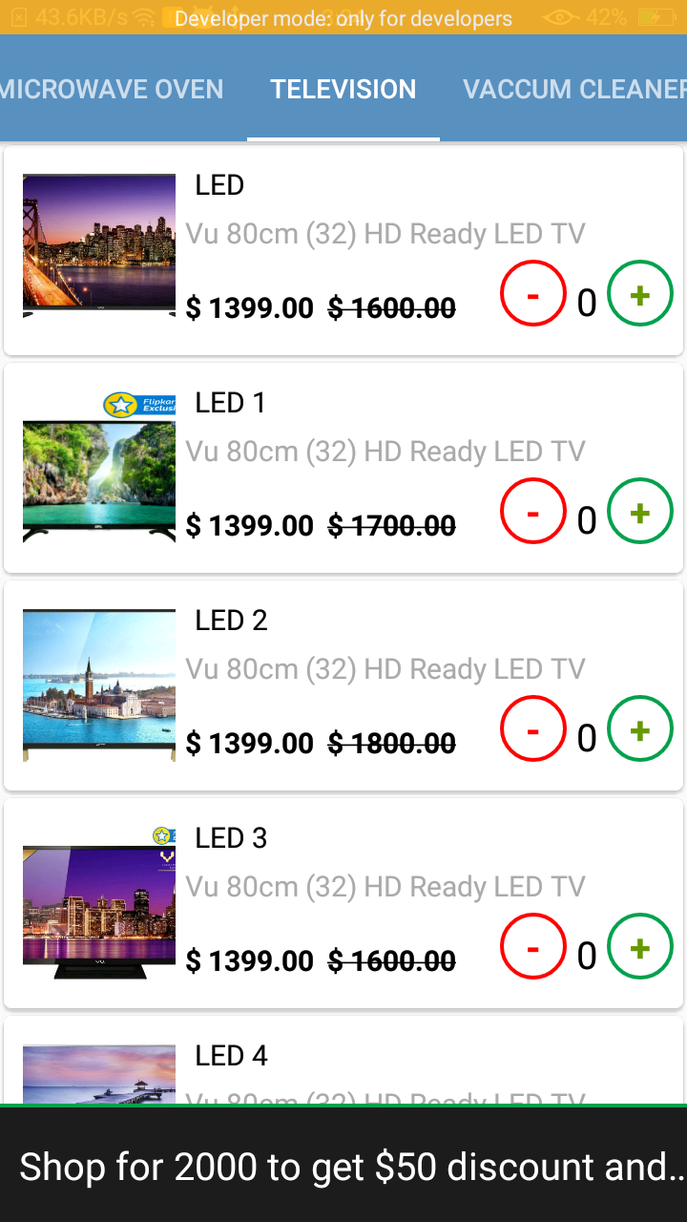

Slide 9
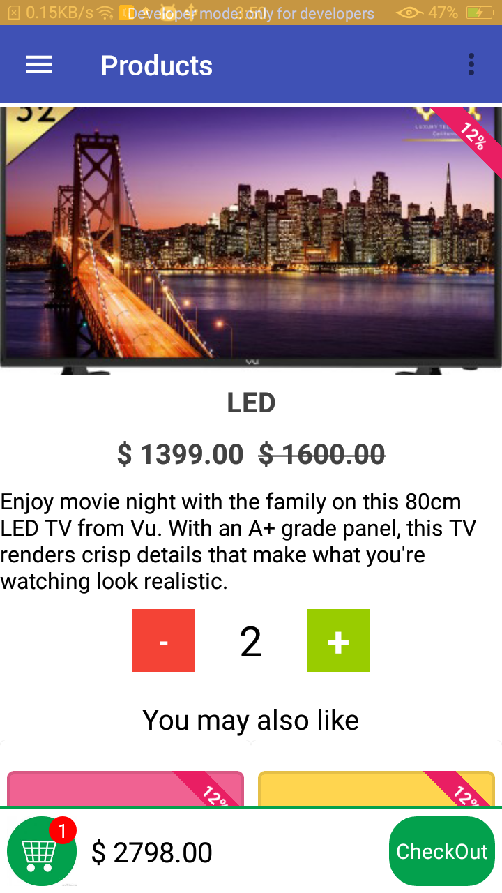
Product Details:
Detail description view of product.
User can Add and remove number of items.

Slide 10
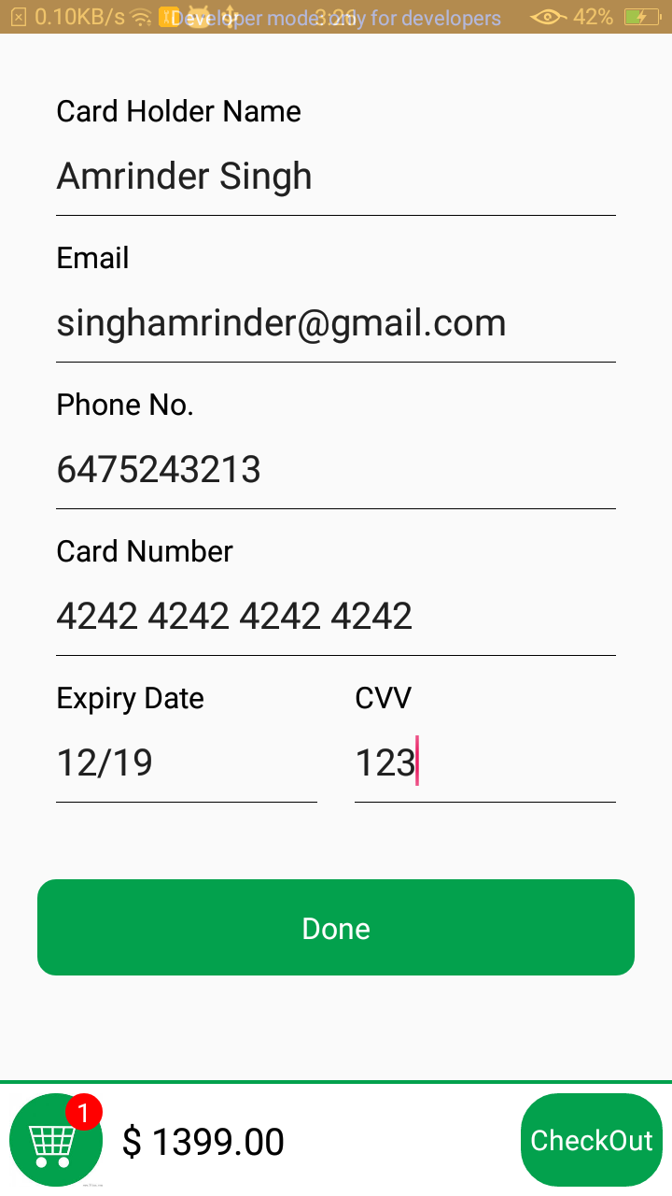
Checkout:
Payment information
User enters payment information .

Slide 11
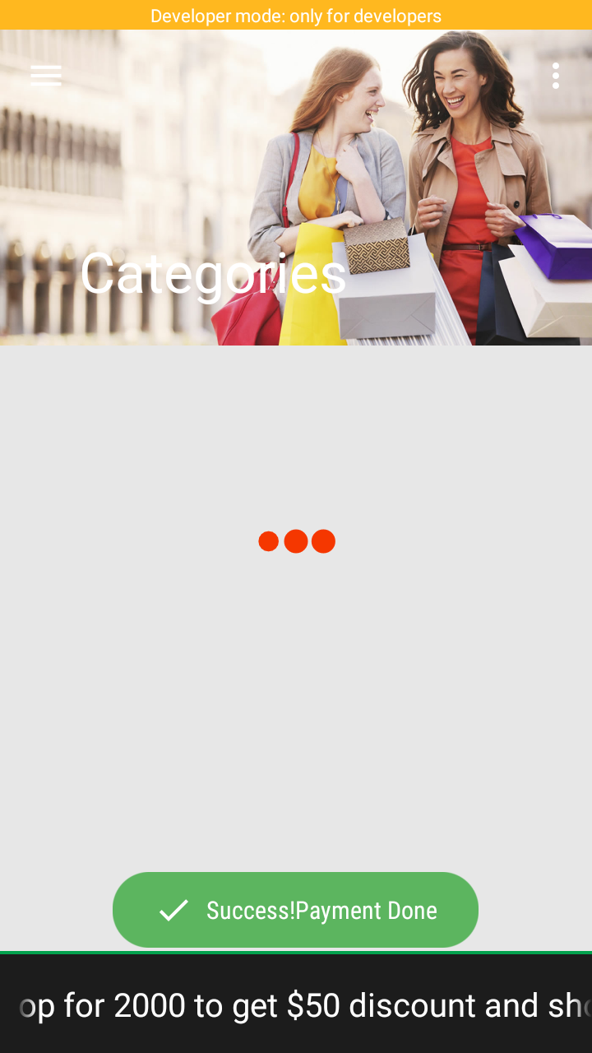
Successful Payment:
Final screen after payment.

Slide 12
Thank You

